Slide 1


BSD 414:
DESIGN THINKING
Lecture 3: Empathy in Design Thinking
Notes:
The design thinking process is used by people working in STEM as a method to solving problems. Major organisations often have a ‘Design Thinking’ Team or ‘Innovation’ Team who work solely in this way, such as Transport for London, Uber Eats, AirBnb, Netflix, or OralB. It is an interative process, that challenges assumptions and develops open minded creativity. In its entirety it has 6 steps, and normally focuses on a user or a particular group. The stages are: empathise, define, Ideate, prototype, test, implement. As students may not choose to focus their problem on a particular person, or group of people we have simplified the process to include 4 steps: define, ideas, prototype, test. The infographic on the slide shows that the testing should help then inform your idea to create a better prototype and test again. This iterative cycle then creates a better design in order to implement.

Slide 2
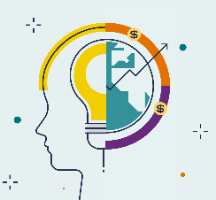
Definition
“Design thinking is a human-centered approach to innovation that draws from the designer's toolkit to integrate the needs of people, the possibilities of technology, and the requirements for business success.”
— Tim Brown, CEO of IDEO
Source and more information: https://voltagecontrol.com/blog/8-great-design-thinking-examples/

Slide 3
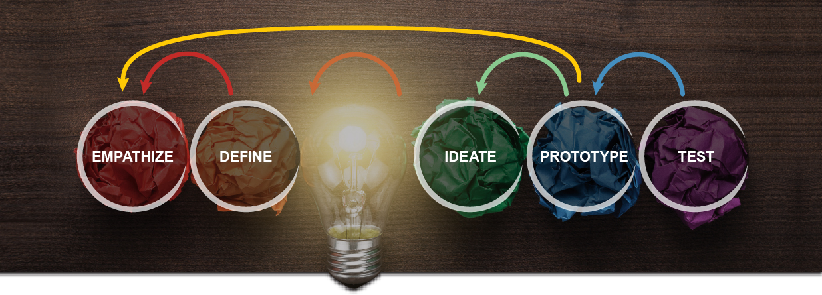
Design Thinking Process

Slide 4
Empathy

Slide 5
Empathize—Research Users' Needs
The ability to understand and share the feelings of another
Ability to sense other people's emotions, coupled with the ability to imagine what someone else might be thinking or feeling
The team aims to understand the problem, typically through user research. Empathy is crucial to design thinking because it allows designers to set aside your assumptions about the world and gain insight into users and their needs.

Slide 6
Empathy
EXEMPLARY TOOLS
Flip chart
Empathy map
Observation
Questionnaire
Ethnographic interviews
Sticky notes
Analysis of the environment and needs in the context of functionality
Whiteboard

Slide 7
Empathize—Research Users' Needs
This is the easiest way to profile a user.
The map allows to understand what users of the product feel and think and to determine their needs.
The advantage of this tool is the clear structure of the map, even for people not involved in the process of its creation.
Areas relate to product user interactions and internal feelings.

Slide 8
The empathy map is a tool to better understand the client
We divide a piece of paper into six areas:
What does the user see?
What does the user hear?
What does the user think and feel?
What does the user say and do?
What are the user's problems?
What are the user's needs?

Slide 9
Application of empathy map
You choose a specific user of the product (we specify his age, occupation, other basic data).
You prepare the empathy map template and personalize the user.
You go through the next questions, taking notes. The preferred order of questions is:
Sees
Hears
Thoughts
Says
Problems
Needs
Summary of the empathy map and considering which elements are the most important.

Slide 10
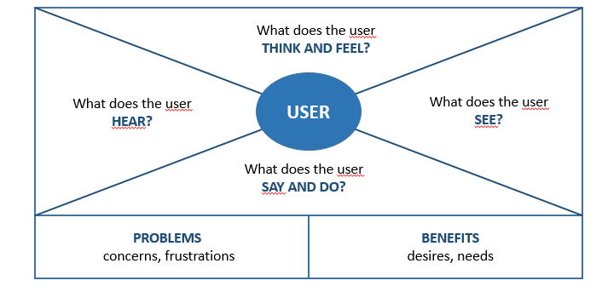
Empathize Map

Slide 11
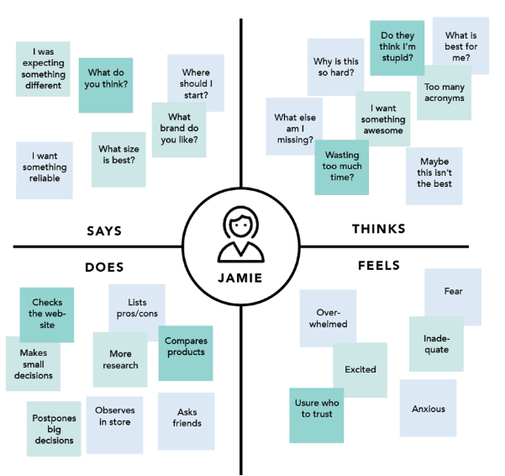
Empathize Map

Slide 12
Empathize—Says
The Says quadrant contains what the user says out loud in an interview or some other usability study. Ideally, it contains verbatim and direct quotes from research.
“I am allegiant to Delta because I never have a bad experience.”
“I want something reliable.”
“I don’t understand what to do from here.”

Slide 13
Empathize—Thinks
The Thinks quadrant captures what the user is thinking throughout the experience. Ask yourself (from the qualitative research gathered): what occupies the user’s thoughts?
What matters to the user? It is possible to have the same content in both Says and Thinks. However, pay special attention to what users think, but may not be willing to vocalize.
Try to understand why they are reluctant to share — are they unsure, self-conscious, polite, or afraid to tell others something?
“This is really annoying.”
“Am I dumb for not understanding this?”

Slide 14
Empathize—Does
The Does quadrant encloses the actions the user takes.
From the research, what does the user physically do?
How does the user go about doing it?
Refreshes page several times.
Shops around to compare prices.

Slide 15
Empathize—Feels
The Feels quadrant is the user’s emotional state, often represented as an adjective plus a short sentence for context. Ask yourself: what worries the user? What does the user get excited about? How does the user feel about the experience?
Impatient: pages load too slowly
Confused: too many contradictory prices
Worried: they are doing something wrong

Slide 16
Empathize—Feels
The Feels quadrant is the user’s emotional state, often represented as an adjective plus a short sentence for context. Ask yourself: what worries the user? What does the user get excited about? How does the user feel about the experience?
Impatient: pages load too slowly
Confused: too many contradictory prices
Worried: they are doing something wrong

Slide 17
Process of Building an Empathy Map
Define scope and goals
What user or persona will you map? Will you map a persona or an individual user? Always start with a 1:1 mapping (1 user/persona per empathy map). This means that, if you have multiple personas, there should be an empathy map for each.
b. Define your primary purpose for empathy mapping. Is it to align the team on your user? If so, be sure everyone is present during the empathy-mapping activity. Is it to analyze an interview transcript? If so, set a clear scope and timebox your effort to ensure you have time to map multiple user interviews.

Slide 18
Process of Building an Empathy Map
Collect research
Gather the research you will be using to fuel your empathy map.
Empathy mapping is a qualitative method, so you will need qualitative inputs: user interviews, field studies, diary studies, listening sessions, or qualitative surveys.

Slide 19
Process of Building an Empathy Map
Gather materials
Your purpose should dictate the medium you use to create an empathy map. If you will be working with an entire team, have a large whiteboard, sticky notes, and markers readily available.
(The outcome will look somewhat like the illustration above.) If empathy mapping alone, create a system that works for you. The easier to share out with the rest of the team, the better.

Slide 20
Process of Building an Empathy Map
Individually generate sticky notes for each quadrant
Once you have research inputs, you can proceed to mapping as a team. In the beginning, everybody should read through the research individually. As each team member digests the data, they can fill out sticky notes that align to the four quadrants. Next, team members can add their notes to the map on the whiteboard.

Slide 21
Process of Building an Empathy Map
Converge to cluster and synthesize
In this step, the team moves through the stickies on the board collaboratively and clusters similar notes that belong to the same quadrant. Name your clusters with themes that represent each group (for example, “validation from others” or “research”). Repeat themes in each quadrant if necessary.
The activity of clustering facilitates discussion and alignment — the goal being to arrive at a shared understanding of your user by all team members.
Once your empathy map is clustered, you can begin to vocalize and align as a team on your findings. What outliers (or data points that did not fit in any cluster) are there? What themes were repeated in all the quadrants? What themes only exist in one quadrant? What gaps exist in our understanding?

Slide 22
Process of Building an Empathy Map
Polish and plan
If you feel that you need more detail or you have unique needs, adapt the map by including additional quadrants (like Goals the example below) or by increasing specificity to existing quadrants.
Depending on the purpose of your empathy map, polish and digitize the output accordingly. Be sure to include the user, any outstanding questions, the date and version number. Plan to circle back to the empathy map as more research is gathered or to guide UX decisions.

Slide 23
Process of Building an Empathy Map
Polish and plan
If you feel that you need more detail or you have unique needs, adapt the map by including additional quadrants (like Goals the example below) or by increasing specificity to existing quadrants.
Depending on the purpose of your empathy map, polish and digitize the output accordingly. Be sure to include the user, any outstanding questions, the date and version number. Plan to circle back to the empathy map as more research is gathered or to guide UX decisions.

Slide 24
CONCLUSION
As their name suggests, empathy maps simply help us build empathy with our end users. When based on real data and when combined with other mapping methods, they can:
Remove bias from our designs and align the team on a single, shared understanding of the user
Discover weaknesses in our research
Uncover user needs that the user themselves may not even be aware of
Understand what drives users’ behaviors
Guide us towards meaningful innovation

Slide 25
References
Bland, D. "Agile coaching tip – What is an empathy map?" 21 April 2016. Retrieved from https://www.solutionsiq.com/resource/blog-post/what-is-an-empathy-map/
Gray, D., Brown, S. & Macanufo, J. 2010. Gamestorming – A playbook for innovators, rulebreakers and changemakers. Sebastopol, CA: O’Reilly Media, Inc.
Gray, D. "Updated Empathy Map Canvas." Medium. 15 July 2017. https://medium.com/the-xplane-collection/updated-empathy-map-canvas-46df22df3c8a

Slide 26


Notes:
The design thinking process is used by people working in STEM as a method to solving problems. Major organisations often have a ‘Design Thinking’ Team or ‘Innovation’ Team who work solely in this way, such as Transport for London, Uber Eats, AirBnb, Netflix, or OralB. It is an interative process, that challenges assumptions and develops open minded creativity. In its entirety it has 6 steps, and normally focuses on a user or a particular group. The stages are: empathise, define, Ideate, prototype, test, implement. As students may not choose to focus their problem on a particular person, or group of people we have simplified the process to include 4 steps: define, ideas, prototype, test. The infographic on the slide shows that the testing should help then inform your idea to create a better prototype and test again. This iterative cycle then creates a better design in order to implement.

